Slide 1
GDIT: An Overview

Slide 2
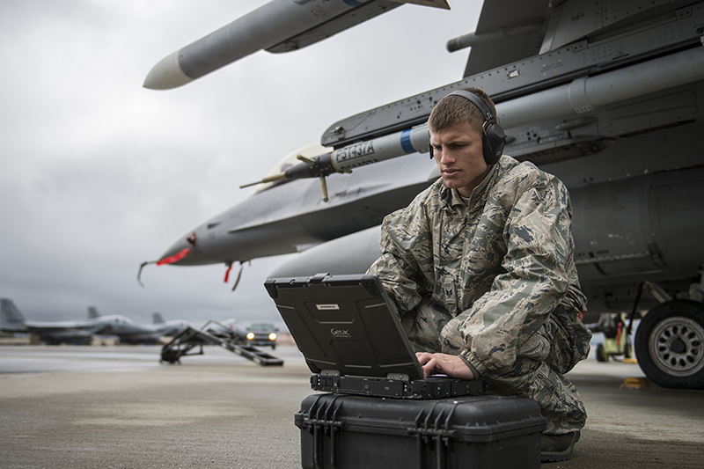
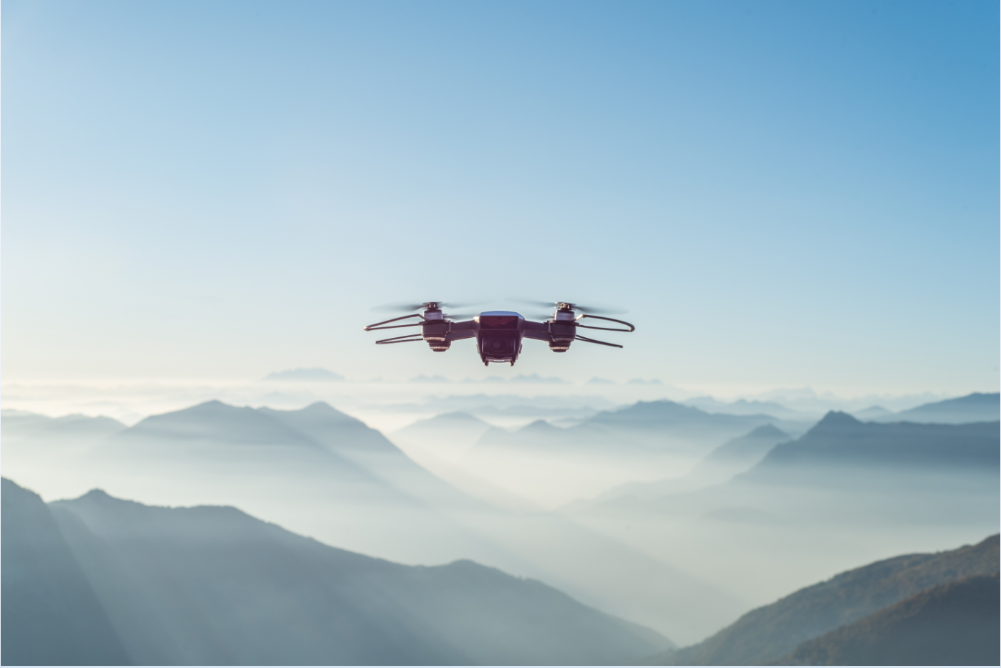
General Dynamics Phebe N. Novakovic, Chairman and CEO
2018 REVENUE
$36 Billion
WORLDWIDE EMPLOYEES
90,000+
BUSINESS UNITS
10
OPERATING GROUPS
5
AEROSPACE
COMBAT SYSTEMS
MARINE SYSTEMS
MISSION SYSTEMS
INFORMATION TECHNOLOGY
Manufactures Gulfstream aircraft and provides comprehensive services for aircraft owners and operators.
Designs, manufactures and integrates land combat machines.
Designs, builds and repairs ships and submarines.
Leading integrator of C4ISR solutions for land, sea, air, space and cyber defense.
Delivers strategy, technology transformations and mission services.
Gulfstream
Jet Aviation
Land Systems
Ordinance and Tactical Systems
European Land Systems
Electric Boat
Bath Iron Works
NASSCO
GD Mission Systems
GDIT

Slide 3

Diverse and Talented Workforce
ABOUT GDIT
35K+
EMPLOYEES
14K+
TECHNOLOGISTS
8K+
VETERANS
We are GDIT. The people supporting and securing some of the most complex government, defense and intelligence projects across the country. We deliver. Bringing the expertise needed to understand and advance critical missions. We transform. Shifting the ways clients invest in, integrate and innovate technology solutions.
We ensure today is safe and tomorrow is smarter. We are there. On the ground, beside our clients, in the lab, and everywhere in between, offering the technology transformations, strategy, and mission services needed to get the job done.
Global Operations
400
CUSTOMER LOCATIONS
270
FACILITIES
30
COUNTRIES
Experience
50+
YEARS OF SERVICE
90+
ALLIANCE PARTNERS
STRATEGY TECHNOLOGY MISSION SERVICES
WHO WE SERVE
Defense
Health
Federal Civilian
Intelligence Community
State
National Security

Slide 4
Technology
Big Data Analytics
Cloud-Hosted Analytics
Data Science, Artificial Intelligence and Machine Learning
Enterprise Data Management
Modern Business Intelligence/ Data Warehousing
Iaas/PaaS
Cloud Strategy and Readiness
Cloud Architecture and Modernization
Cloud Migration
Cloud Security
Cloud Brokerage and Operations
Logistics and Supply Chain
Talent Management
Financial Management
Case Management
Analytics
Cloud
Enterprise Business Solutions
Deep Learning Frameworks
Predictive Modeling
Speech/Facial Recognition APIs
Language Understanding Platforms
Cyber Defense
Cyber Risk
Cyber Operations
Cyber Resilience
Cyber Analytics
Cyber Training
IT Managed Services
Journey to Managed Services
Shared Services
Business Process as a Service
Artificial Intelligence
Cyber
Managed Services
Agile
DevSecOps
Digital Design
Cloud-Native Apps
App Modernization
Mobile Solutions
Networking/SDN
IT Service Desk and Management
Unified Communications
Infrastructure and Data Center Services
High-Performance Computing
Enterprise Mobility and Internet of Things
IT Operational Insights
Application Development
Enterprise IT

Slide 5
Hack Machine Learning Challenges
Contextual Search
Image Classification

Slide 6

Contextual Search: Background
Search for textual information that is semantically similar to other texts is a fundamental challenge in information retrieval. Many methods have been applied to convert unstructured text into structured information that can be searched, compared, and classified including:
Keyword with Boolean (“high” AND ” seas”)
Expanded vocabulary (thesaurus, concepts)
Statistical (TF-IDF)
NLP (semantic, entity, and event)
Deep Learning trained word embeddings (Word2Vec, Stanford GloVE, etc.)

Slide 7
Contextual Search: Challenge
Recent improvements on word embeddings are demonstrating significant improvement over all previous methods.
Locate a large corpus of text, and use next generation word embeddings that have contextual awareness of how a word is used in a sentence, to create a “More Like This” search. In addition, demonstrate the use of the solution and discuss its applicability across various use cases

Slide 8
Contextual Search: Prizes
1st Place
Apple Airpods
GDIT wireless charger
GDIT Yeti mug
2nd Place
Amazon Echo
GDIT wireless charger
GDIT yeti
3rd Place
GDIT yeti
GDIT wireless charger

Slide 9


Image Classification: Background
We are living in a golden age of AI, driven by Deep Learning successes built with open-source tools that include a rich array of network topologies, running on GPU-boosted compute, learning from very large corpus of labeled data.
The progenitor of this explosion was the ImageNet competition – it revolutionized image detection, recognition, and classification solutions.

Slide 10
Image Classification: Challenge
Locate at least two pre-trained image classification Deep Learning Networks – apply them to a corpus of images we will provide – and compare their performance. Select the “best” performing network and use it against a second set of images we provide to detect objects in images and create a listing of which images contain which objects, e.g. “Images 1, 7, and 10 have Cats”, “Images 1, 32, and 99 have Trees”, etc. In addition, demonstrate the use of the solution and discuss its applicability across various use cases

Slide 11
Contextual Search: Prizes
1st Place
Apple Airpods
GDIT wireless charger
GDIT Yeti mug
2nd Place
Amazon Echo
GDIT wireless charger
GDIT yeti
3rd Place
GDIT yeti
GDIT wireless charger

Slide 12
HACK MACHINE LEARNING: Office Hours
Friday, October 18: 4 – 9p.m.
Saturday, October 19: 3 – 9 p.m.
Sunday, October 20: 10 – 2 p.m.

